Slide 1

Quantum Optimization Quantum Relax-and-Round (QRR) Algorithm
Eraraya Ricardo Muten
Technical University of Munich, Quantum Science & Technology Mentor: Lilly Palackal
27 June 2024 “Extending relax-and-round combinatorial optimization solvers with quantum correlations” (PhysRevA.109.012429). Paper by Maxime Dupont and Bhuvanesh Sundar.
Notes:
1

Slide 2
QAOA in a Nutshell (Refresher)
Minimize $⟨{\hat{H}}_{C}⟩$ with respect to the $(\vec{γ},\vec{β})$ parameters.
1
Eraraya Ricardo Muten | TUM | Seminar: Advanced Topics in Quantum Computing

Slide 3
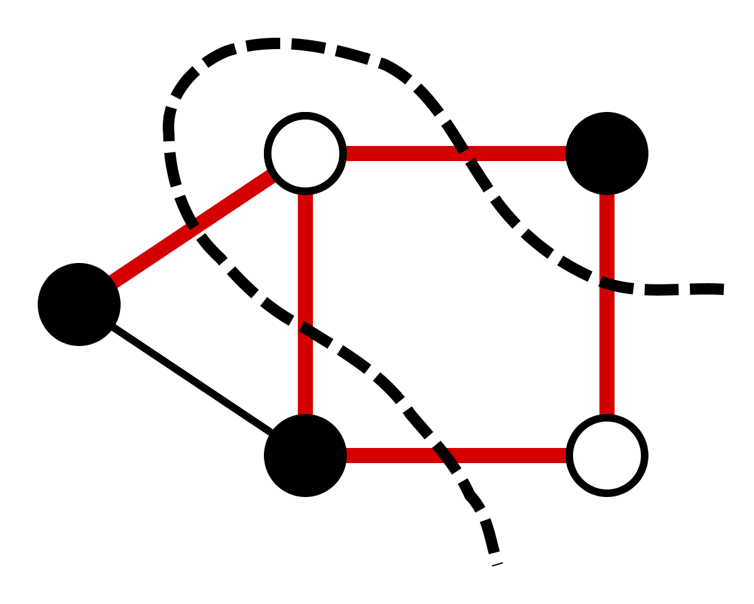


MaxCut in a Nutshell (Refresher)
Given a graph, find a way to separate the vertices into two groups so that it maximizes the total number of edges that are “cut” (two vertices of that edge belong to different group).
$$C\left(z\right)=\sum_{α=1}^{m}{ }C_{α}\left(z\right)$$
$$\begin{aligned}&{\hat{H}}_{C}=−\frac{1}{2}\sum_{i,j}{ }w_{i,j}\left(I−{\hat{Z}}_{i}{\hat{Z}}_{j}\right)\end{aligned}$$
2
Eraraya Ricardo Muten | TUM | Seminar: Advanced Topics in Quantum Computing

Slide 4
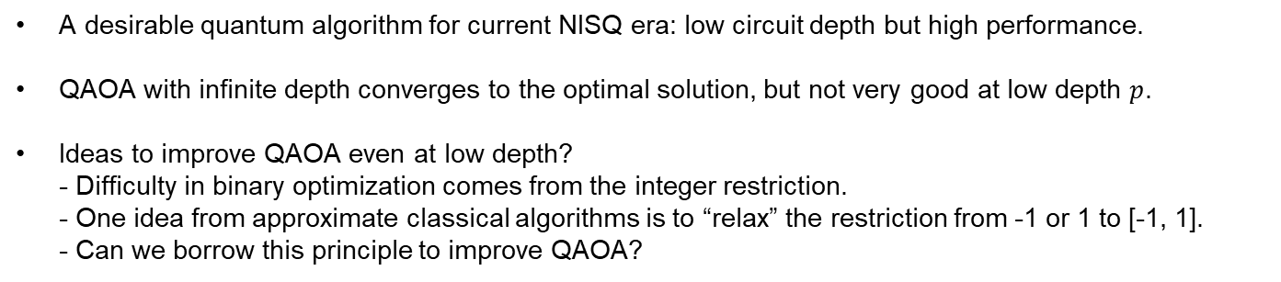
Motivations for the QRR algorithm
A desirable quantum algorithm for current NISQ era: low circuit depth but high performance.
QAOA with infinite depth converges to the optimal solution, but not very good at low depth $p$.
Ideas to improve QAOA even at low depth? - Difficulty in binary optimization comes from the integer restriction. - One idea from approximate classical algorithms is to “relax” the restriction from -1 or 1 to [-1, 1]. - Can we borrow this principle to improve QAOA?
3
Eraraya Ricardo Muten | TUM | Seminar: Advanced Topics in Quantum Computing

Slide 5
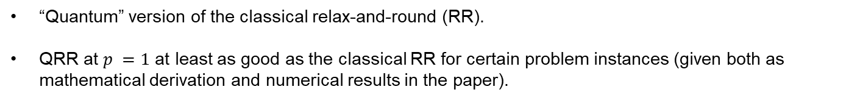
Idea Proposed by the Paper
“Quantum” version of the classical relax-and-round (RR).
QRR at $p =1$ at least as good as the classical RR for certain problem instances (given both as mathematical derivation and numerical results in the paper).
4
Eraraya Ricardo Muten | TUM | Seminar: Advanced Topics in Quantum Computing

Slide 6
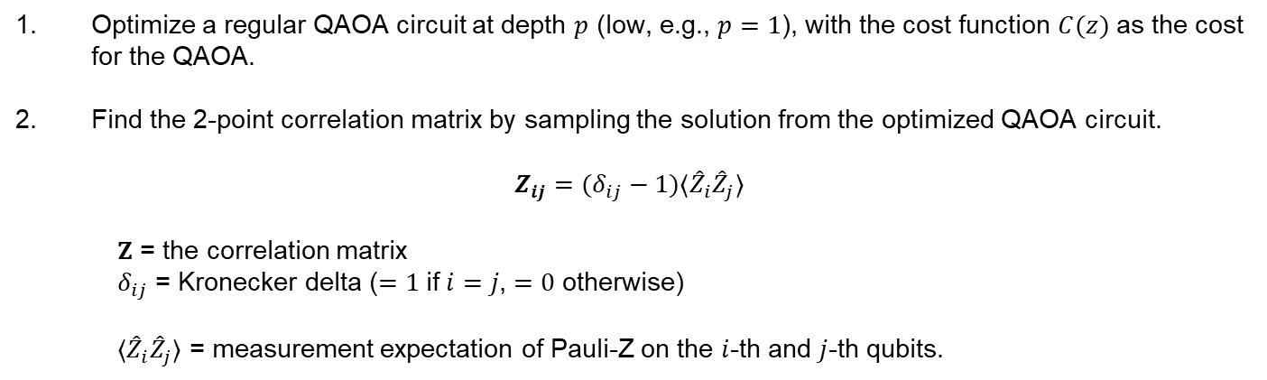
QRR Algorithm Step-by-Step
Optimize a regular QAOA circuit at depth $p$ (low, e.g., $p=1$), with the cost function $C(z)$ as the cost for the QAOA.
Find the 2-point correlation matrix by sampling the solution from the optimized QAOA circuit.
$$Z_{ij}=(δ_{ij}−1)⟨{\hat{Z}}_{i}{\hat{Z}}_{j}⟩$$
$Z$ = the correlation matrix
$δ_{ij}$ = Kronecker delta ($=1$if $i=j$, $=0$ otherwise)
$⟨{\hat{Z}}_{i}{\hat{Z}}_{j}⟩$ = measurement expectation of Pauli-Z on the $i$-th and $j$-th qubits.
5
Eraraya Ricardo Muten | TUM | Seminar: Advanced Topics in Quantum Computing

Slide 7
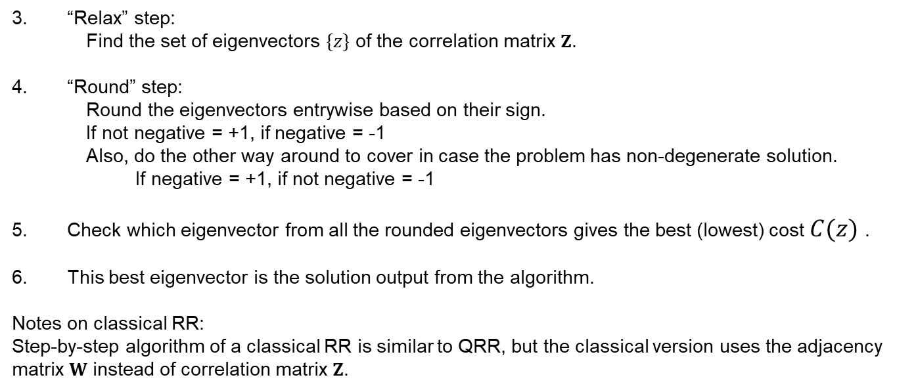
QRR Algorithm Step-by-Step
“Relax” step:
Find the set of eigenvectors $\{z\}$ of the correlation matrix $Z$.
“Round” step:
Round the eigenvectors entrywise based on their sign.
If not negative = +1, if negative = -1
Also, do the other way around to cover in case the problem has non-degenerate solution.
If negative = +1, if not negative = -1
Check which eigenvector from all the rounded eigenvectors gives the best (lowest) cost $C(z)$ .
This best eigenvector is the solution output from the algorithm.
Notes on classical RR:
Step-by-step algorithm of a classical RR is similar to QRR, but the classical version uses the adjacency matrix $W$ instead of correlation matrix $Z$.
6
Eraraya Ricardo Muten | TUM | Seminar: Advanced Topics in Quantum Computing

Slide 8
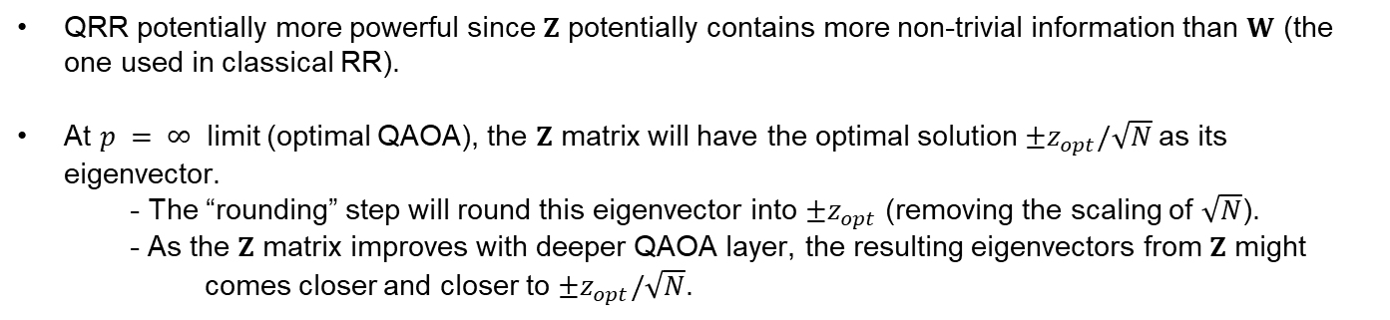
Intuitions about the QRR
QRR potentially more powerful since $Z$ potentially contains more non-trivial information than $W$ (the one used in classical RR).
At $p = ∞⁡$ limit (optimal QAOA), the $Z$ matrix will have the optimal solution $±z_{opt}/\sqrt{N}$as its eigenvector.
- The “rounding” step will round this eigenvector into ${±z}_{opt}$ (removing the scaling of $\sqrt{N}$).
- As the $Z$ matrix improves with deeper QAOA layer, the resulting eigenvectors from $Z$ might comes closer and closer to $±z_{opt}/\sqrt{N}$.
7
Eraraya Ricardo Muten | TUM | Seminar: Advanced Topics in Quantum Computing

Slide 9
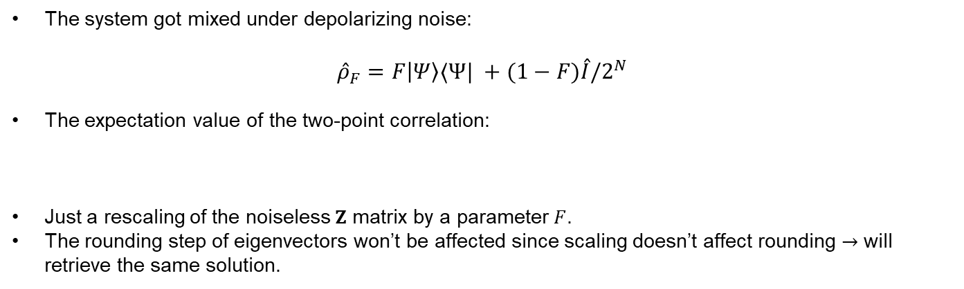
QRR Robustness to Depolarizing Noise
The system got mixed under depolarizing noise:
$${\overset{ˆ}{ρ}}_{F}=F\left|Ψ\right\rangle ⟨{Ψ|}_{ }+(1−F)\overset{ˆ}{I}/2^{N}$$
The expectation value of the two-point correlation:
Just a rescaling of the noiseless $Z$ matrix by a parameter $F$.
The rounding step of eigenvectors won’t be affected since scaling doesn’t affect rounding $→$ will retrieve the same solution.
8
Eraraya Ricardo Muten | TUM | Seminar: Advanced Topics in Quantum Computing

Slide 10
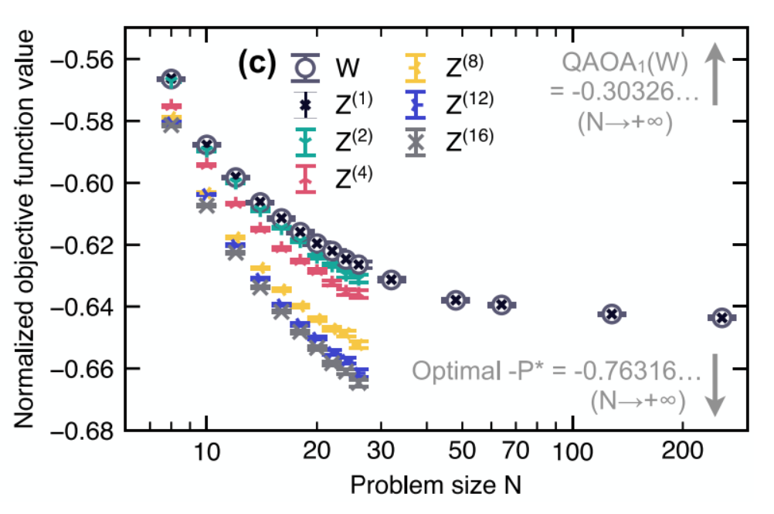
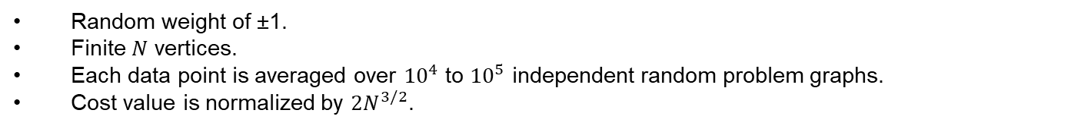
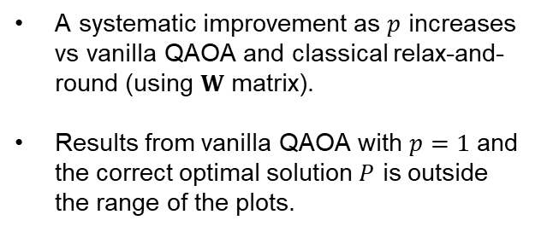
Numerical result 1: Sherrington-Kirkpatrick (SK) Spin Glasses Graphs
Random weight of ±1.
Finite $N$ vertices.
Each data point is averaged over ${10}^{4}$ to ${10}^{5}$ independent random problem graphs.
Cost value is normalized by $2N^{3/2}$.
A systematic improvement as $p$ increases vs vanilla QAOA and classical relax-and-round (using $W$ matrix).
Results from vanilla QAOA with $p=1$ and the correct optimal solution $P$ is outside the range of the plots.
9
Eraraya Ricardo Muten | TUM | Seminar: Advanced Topics in Quantum Computing

Slide 11
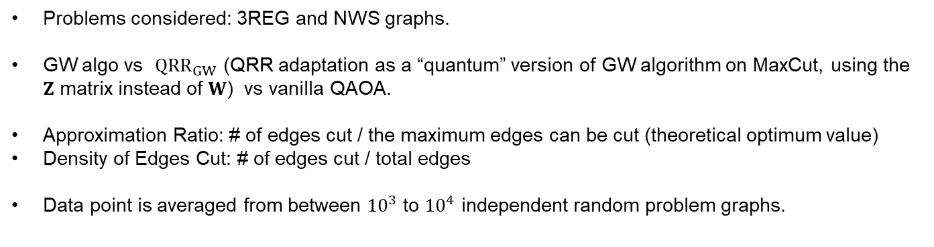
Numerical result 2: Comparison to Goemans-Williamson (GW)
Problems considered: 3REG and NWS graphs.
GW algo vs ${QRR}_{GW}$ (QRR adaptation as a “quantum” version of GW algorithm on MaxCut, using the $Z$ matrix instead of $W$) vs vanilla QAOA.
Approximation Ratio: # of edges cut / the maximum edges can be cut (theoretical optimum value)
Density of Edges Cut: # of edges cut / total edges
Data point is averaged from between ${10}^{3}$ to ${10}^{4}$ independent random problem graphs.
10
Eraraya Ricardo Muten | TUM | Seminar: Advanced Topics in Quantum Computing

Slide 12
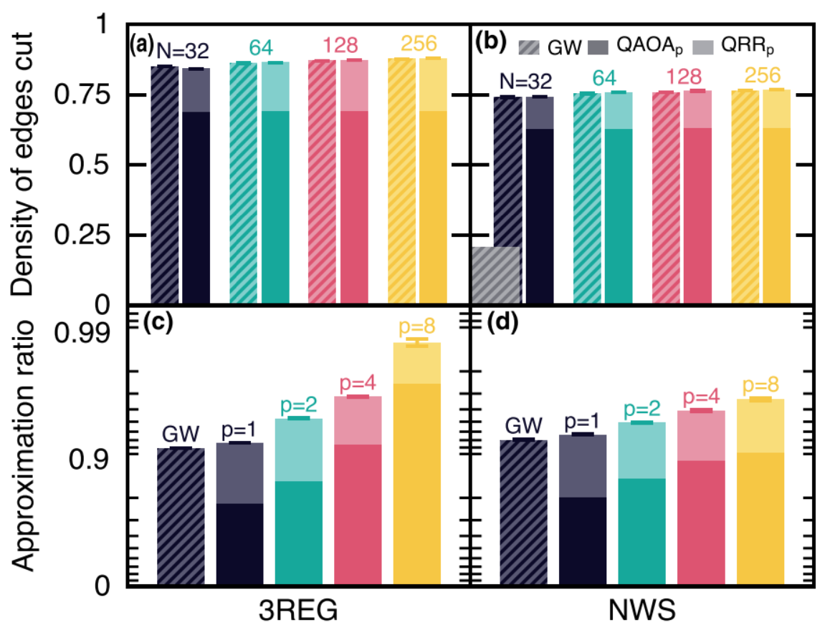
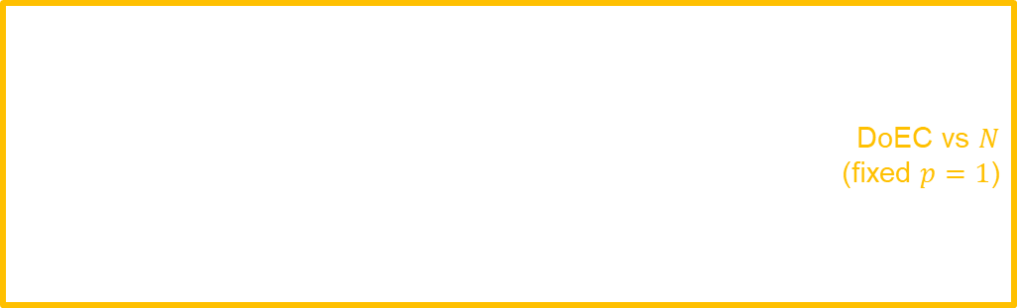
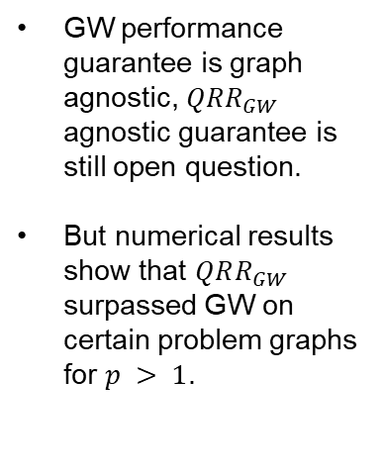
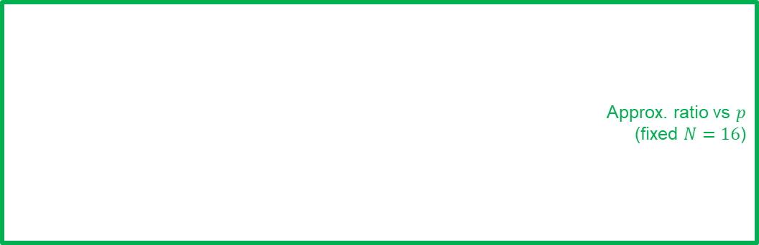
Numerical result 2: Comparison to Goemans-Williamson (GW)
DoEC vs $N$
(fixed $p=1$)
GW performance guarantee is graph agnostic, $QRR_{GW}$ agnostic guarantee is still open question.
But numerical results show that $QRR_{GW}$ surpassed GW on certain problem graphs for $p > 1$.
Approx. ratio vs $p$
(fixed $N=16$)
11
Eraraya Ricardo Muten | TUM | Seminar: Advanced Topics in Quantum Computing

Slide 13
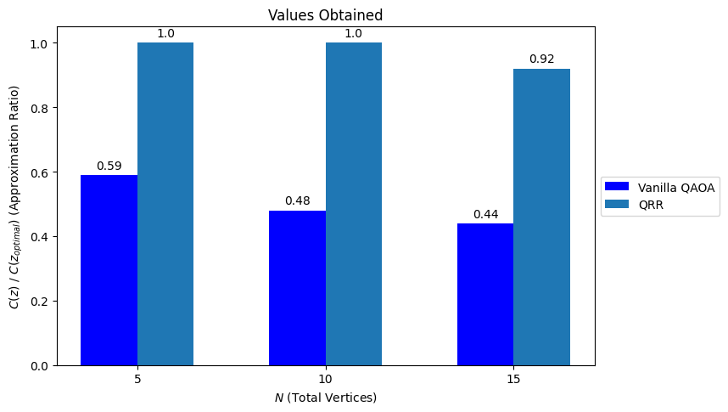
Self Prototype 1: MaxCut of Random Graphs
1 layer of QAOA, statevector simulator, bitstrings are then sampled, 1000 shots.
N = 5, 10, and 15 vertices (5, 10, and 15 qubits).
Averaged from 10 random graphs.
Normalized with respect to the optimal value (found with classical optimization tool Gurobi, assumed to be optimal).
Each QAOA result is obtained by averaging all the bitstrings, while the QRR result is obtained from the single best sign-rounded eigenvector.
12
Eraraya Ricardo Muten | TUM | Seminar: Advanced Topics in Quantum Computing

Slide 14
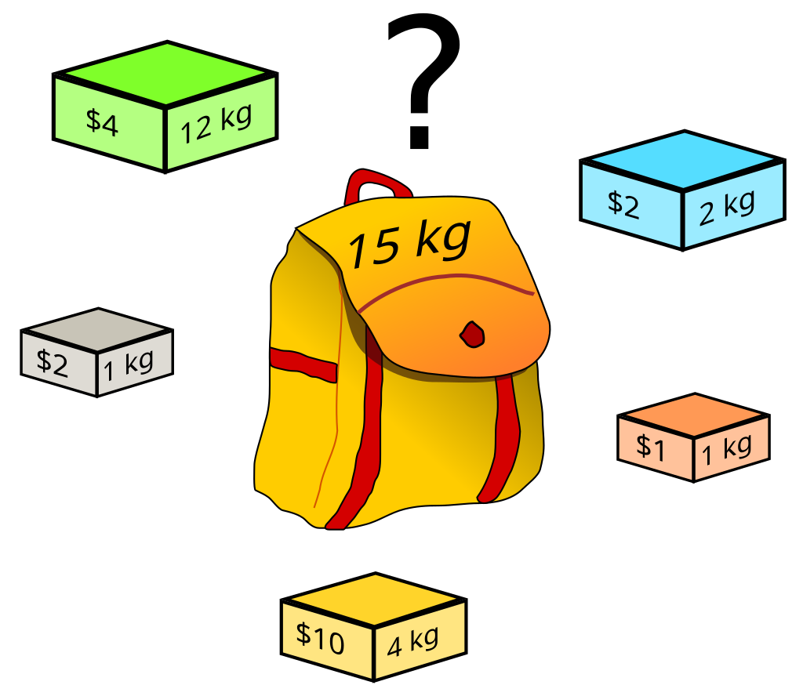
Self Prototype 2: Knapsack Problems
Knapsack problem: Given a list of items that each has certain value and weight, find the optimal configuration that gives the highest total values on which items to select under a constraint of a maximum weight.
Unique main difference vs MaxCut: MaxCut has no constraint, while Knapsack is an optimization problem with a constraint.
13
Eraraya Ricardo Muten | TUM | Seminar: Advanced Topics in Quantum Computing

Slide 15
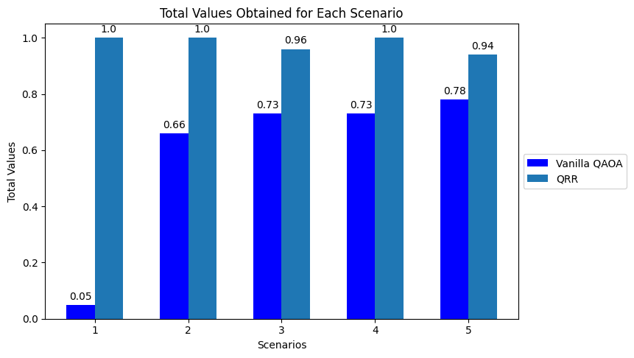
Self Prototype 2: Knapsack Problems
200 layers of QAOA, 10000 shots (statevector simulator, bitstrings are then sampled).
QAOA parameters aren’t optimized, but mimic the annealing process of adiabatic quantum computation to save runtime for this demo.
7-12 qubits.
Each QAOA result is obtained by averaging all the feasible bitstrings, while the QRR result is obtained from the single best feasible sign-rounded eigenvector.
Normalized with respect to the optimal value.
QRR almost always found the optimal solution (at least for the scenarios tried).
The vanilla QAOA results are from the averages of all feasible bitstrings.
14
Eraraya Ricardo Muten | TUM | Seminar: Advanced Topics in Quantum Computing

Slide 16
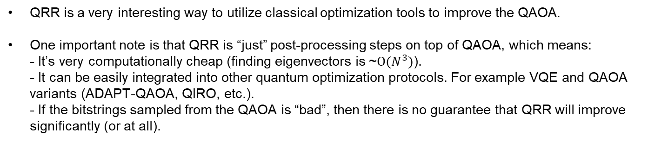
Closing Remarks
QRR is a very interesting way to utilize classical optimization tools to improve the QAOA.
One important note is that QRR is “just” post-processing steps on top of QAOA, which means: - It’s very computationally cheap (finding eigenvectors is ~$O(N^{3})$). - It can be easily integrated into other quantum optimization protocols. For example VQE and QAOA variants (ADAPT-QAOA, QIRO, etc.). - If the bitstrings sampled from the QAOA is “bad”, then there is no guarantee that QRR will improve significantly (or at all).
15
Eraraya Ricardo Muten | TUM | Seminar: Advanced Topics in Quantum Computing

Slide 17
Thank you for listening! Any questions?
https://github.com/ericardomuten/qrr
16
Eraraya Ricardo Muten | TUM | Seminar: Advanced Topics in Quantum Computing

